Slide 1
Information Retrieval SS 2025
Exercise 1: Boolean Retrieval, Phrase and Proximity Queries, Tolerant Retrieval
Saad Obaid ul Islam
partially based on “An Introduction to Information Retrieval” by Manning, Raghavan and Schütze

Slide 2
Boolean Retrieval

Slide 3
Task 1, Task 2
Consider the following document collection (Assume the text is preprocessed by lowercasing and stopword removal. Also consider Facebook's as two tokens: Facebook and 's).
Doc 1 Facebook's new tool is called Graph Search.
Doc 2 A new social graph for LinkedIn users.
Doc 3 Find friends using search on Facebook.
Doc 4 Google's Knowledge Graph lets you search for things, people, or places.
Draw the term-document incidence matrix for this document collection.
Draw the inverted index representation for this document collection, showing the dictionary and the postings.
term | Doc 1 | Doc 2 | Doc 3 | Doc 4
facebook | 1 | 0 | 1 | 0
‘s | 1 | 0 | 0 | 1
new | 1 | 1 | 0 | 0
tool | 1 | 0 | 0 | 0
called | 1 | 0 | 0 | 0
graph | 1 | 1 | 0 | 1
social | 0 | 1 | 0 | 0
linkedin | 0 | 1 | 0 | 0
users | 0 | 1 | 0 | 0
find | 0 | 0 | 1 | 0
friends | 0 | 0 | 1 | 0
using | 0 | 0 | 1 | 0
search | 1 | 0 | 1 | 1
google | 0 | 0 | 0 | 1
knowledge | 0 | 0 | 0 | 1
things | 0 | 0 | 0 | 1
people | 0 | 0 | 0 | 1
places | 0 | 0 | 0 | 1
facebook
‘s
new
tool
called
graph
social
linkedin
users
find
friends
using
search
google
knowledge
things
people
places
1
3
1
4
1
2
1
1
1
2
4
2
2
2
3
3
3
1
3
4
4
4
4
4
4

Slide 4
Task 3
Use both the term-document incidence matrix and the inverted index to compute the results return for the following queries:
graph AND search
graph AND NOT (google OR facebook)
graph AND search:
1 1 0 1 graph
AND 1 0 1 1 search
1 0 0 1 graph AND search
graph
search
graph AND search
1
2
4
1
3
4
1
4

Slide 5
Task 3
Use both the term-document incidence matrix and the inverted index to compute the results return for the following queries:
graph AND search
graph AND NOT (google OR facebook)
graph AND NOT (google OR facebook)
0 0 0 1 google
OR 1 0 1 0 facebook
NOT 1 0 1 1 google OR facebook
0 1 0 0 NOT (google OR facebook)
AND 1 1 0 1 graph
0 1 0 0 graph AND NOT (google OR facebook)
google
facebook
google OR facebook
NOT (google OR facebook)
graph
graph AND NOT (google OR facbook)
4
1
3
1
3
4
2
1
2
4
2

Slide 6
Task 4
For a conjunctive query, is processing postings lists in order of size guaranteed to be optimal? Explain why it is, or give an example where it isn't.
The order is not guaranteed to be optimal. Consider three terms with postings list sizes s1 = 100, s2 = 105 and s3 = 110. Suppose the intersection of s1 and s2 has length 100 and the intersection of s1 and s3 length 0. The ordering s1, s2, s3 requires 100+105+100+110=315 steps through the postings lists. The ordering s1, s3, s2 requires 100+110+0+0=210 steps through the postings lists.
s1
s2
s3
Task 5
What is the complexity (in big O notation) for a query x AND y when the postings lists are sorted?
O(x+y)
Task 5 (cont.)
What if they aren't?
O(x*y)

Slide 7
Task 6
How should the Boolean query x AND NOT y be handled?
MERGE(x, y, AND NOT)
answer <- () # Intialize empty answer list
while x != NIL and y != NIL # while both x and y have elements
# Case 1: If current Document ID in (x) is the same in (y), skip the document
do if docID(x) = docID(y)
then x <- next(x)
y <- next(y)
# Case 2: if current document ID in x is smaller than current document ID in y, docID(x) cannot be in y
else if docID(x) < docID(y)
then ADD(answer, docID(x))
x <- next(x)
# Case 3: If current document ID in y is smaller than current document ID in x, it means docID(y) is not relevant to docID(x).
else
y <- next(y)
# After first while loop, one or both list have exhausted. If y is exhausted but x still has elements, all remaining elements in x are not in y.
while x != NIL do
ADD(answer, docID(x)) # Add all remaining docID(x) to the answer
return(answer)

Slide 8
Task 6 (cont.)
Why is the naive evaluation of the query, i.e. evaluating NOT y first and then x AND NOT y, normally very expensive?
Calculating (NOT y) first takes O(N) time, and then it will be merged with x. The overall complexity is O(N).
Task 6 (cont.)
How expensive is a Boolean query x OR y?
O(x+y)
Notes:
OR
X = [1,3,5]
Y = [1,2,4,6]
x == y
x <- next(x)
y <- next(y)
add(answer, docId(x))
x < y
x <- next(x)
add(answer. docId(x))
x > y
y <- next(y)
add(answer, docId(y))
while x != nil
…
while y != nil
…

Slide 9
Boolean Retrieval - Skip Pointers

Slide 10
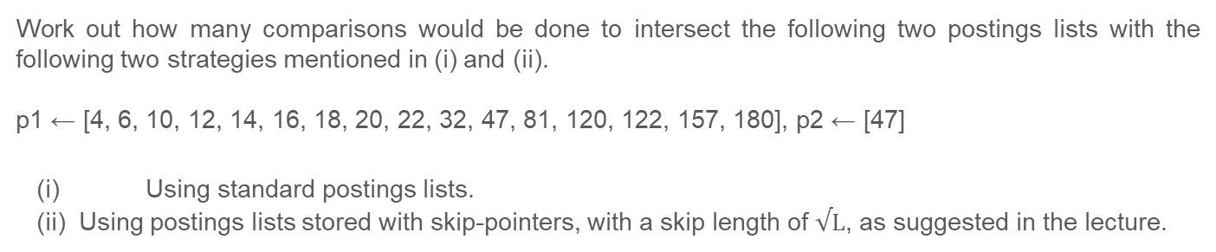
Task 1
Why are skip pointers not useful for queries in the form x OR y?
It is essential to visit every docID in the postings list of either terms.
Task 2
Work out how many comparisons would be done to intersect the following two postings lists with the following two strategies mentioned in (i) and (ii).
p1 ← [4, 6, 10, 12, 14, 16, 18, 20, 22, 32, 47, 81, 120, 122, 157, 180], p2 ← [47]
(i) Using standard postings lists.
(ii) Using postings lists stored with skip-pointers, with a skip length of $√L$, as suggested in the lecture.
(i)
(ii)
Comparisons will be made unless either of the postings list end, i.e. till we reach 47 in the upper postings list, after which the lower list ends. Number of comparisons: 11
Number of comparisons: 6. The following comparisons will be made:
1. (4, 47), 4. (120, 47)
2. (14, 47) 5. (32, 47)
3. (22, 47) 6. (47, 47)
Notes:
Skip-pointers of length: 4

Slide 11
Task 3
Consider a postings intersection between this postings list, with skip pointers:
and the following intermediate result postings list (which hence has no skip pointers):
How often is a skip pointer followed?
How many postings comparisons will be made by this algorithm while intersecting the two lists?
How many postings comparisons are made if the postings lists are intersected without the use of skip pointers?
3
5
9
15
24
39
60
68
75
81
84
89
92
96
97
100
115
3
5
89
95
97
99
100
101
skip-pointer
The skip pointer is followed once. (from 24 to 75)
18 comparisons are made: (3,3), (5,5), (9,89), (15,89), (24,89), (75,89), (92,89), (81,89), (84,89), (89,89), (92,95), (115,95), (96,95), (96,97), (97,97), (100,99), (100,100), (115,101)
19
look-ahead

Slide 12
Boolean Retrieval - Phrase & Proximity Queries

Slide 13
Task 1
Shown below is a portion of a positional index in the format: term: doc1: <position1, position2,...>; doc2: <position1, position2, ...>; etc.
angels: 2: [36,174,252,651]; 4: [12,22,102,432]; 7: [17];
fools: 2: [1,17,74,222]; 4: [8,78,108,458]; 7: [3,13,23,193];
fear: 2: [87,704,722,901]; 4: [13,43,113,433]; 7: [18,328,528];
in: 2: [3,37,76,444,851]; 4: [10,20,110,470,500]; 7: [5,15,25,195];
rush: 2: [2,66,194,321,702]; 4: [9,69,149,429,569]; 7: [4,14,404];
to: 2: [47,86,234,999]; 4: [14,24,774,944]; 7: [199,319,599,709];
tread: 2: [57,94,333]; 4: [15,35,155]; 7: [20,320];
where: 2: [67,124,393,1001]; 4: [11,41,101,421,431]; 7: [16,36,736];
Which document(s), if any, meet each of the following queries, where each expression within quotes is a phrase query
(i) “fools rush in”
(ii) “fools rush in” AND “angels fear to tread”
(i) All three documents (2, 4 and 7).
(ii) Only document 4.

Slide 14
Task 2
Consider the following fragment of a positional index with the same format:
Gates: 1: [3]; 2: [6]; 3: [2,17]; 4: [1]
IBM: 4: [3]; 7: [14];
Microsoft: 1: [1]; 2: [1, 21]; 3: [3]; 5: [16,22,51]
Describe the set of documents that satisfy the query Gates /2 Microsoft
Describe each set of values for k for which the query Gates /k Microsoft returns a different set of documents as the answer.
Documents 1 and 3
{k=1} and K ∈ {x: x ≥ 5} return a different set than {1,3}
→ {k=1} results in {3};
→ K ∈ {x: x ≥ 5} results in {1, 2, 3}.
k ∈ {2, 3, 4} returns the result same set {1, 3}

Slide 15
Tolerant Retrieval

Slide 16
Task 1
Write down the entries in the permuterm index dictionary that are generated by the term Retrieval.
Retrieval$, etrieval$R, trieval$Re, rieval$Ret, ieval$Retr, eval$Retri, val$Retrie, al$Retriev, l$Retrieva, $Retrieval
Task 2
If you want to search for s*ng in a permuterm wildcard index, what key(s) would one do the lookup on?
ng$s*
Task 3
Consider the following example of a postings list in a 3-gram index.
Why is it useful to have the vocabulary terms in the postings lexicographically ordered?
etr
beetroot
metric
petrify
retrieval
We want to use our n-gram index for filtering dictionary candidates -> Need to intersect n-gram postings. Hence, ordering the vocabulary terms allows for intersection in O(x + y) steps.
Notes:
Why do we use the permute index?
- Support wildcard queries in the middle of a term (trailing -> B-Tree of vocab, leading inverted B-Tree of vocab, inbetween -> Permute Index)
Rules:
X -> $X
X* -> $X*
*X -> X$*
X*Y -> Y$X*
ng$s <= w < ng$t
Why use n-gram index?
More space efficient than permuterm index
Can be used to filter cancidates for spelling correction
How does it work?
Divide each term into its n-grams and keep a posting list for each n-gram with all of its words

Slide 17
Task 4
We want to compute the Levenshtein edit distance between Frodo and Gondor. Consider the sub-problem of computing the distance between G and Frod. What are the costs for insertion, deletion and replacement respectively.
Recursive approach:
(insertion, deletion, replacement)
Insertion: 5
Deletion: 4
Replacement: 4
Interpretation of Lev(G, Frod):
Insertion: If we knew the distance of the sub-problem Lev(_, Frod), we could translate Frod to _, and have + 1 ins cost for inserting G.
Deletion: If we knew the distance of the sub-problem Lev(G, Fro), we could translate Fro to G and would be left with d. We’d need one delete operation (+1 del) for removing d.
Replacement: If we knew the distance of the sub-problem Lev(_, Fro), then we could translate Fro to _, and replace G with d (+1 repl, because G ≠ d).
Lev(G, Frod) = min(5, 4, 4)
ins + 1
del + 1
repl + {0, 1}
Lev(_, Frod) = 4
Lev(G, Fro) = min(4, 3, 3)
Lev(_, Fro) = 3*
ins + 1
del + 1
repl + {0, 1}
Lev(_, Fro) = 3*
Lev(G, Fr) = min(3, 2, 2)
Lev(_, Fr) = 2*
ins + 1
del + 1
repl + {0, 1}
Lev(_, Fr) = 2*
Lev(G, F) = min(2, 2, 1)
Lev(_, F) = 1*
ins + 1
repl + {0, 1}
del + 1
Lev(_, F) = 1*
Lev(G, _) = 1
Lev(_, _) = 0
* redundant computations

Slide 18
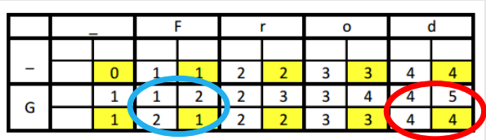

Task 4
We want to compute the Levenshtein edit distance between Frodo and Gondor. Consider the sub-problem of computing the distance between G and Frod. What are the costs for insertion, deletion and replacement respectively.
Lev(G, Frod) = min(5, 4, 4)
Dynamic programming approach:
ins + 1
del + 1
repl + {0, 1}
Lev(_, Frod) = 4
Lev(G, Fro) = min(4, 3, 3)
Lev(_, Fro) = 3*
ins + 1
del + 1
repl + {0, 1}
Lev(_, Fro) = 3*
Lev(G, Fr) = min(3, 2, 2)
Lev(_, Fr) = 2*
ins + 1
del + 1
repl + {0, 1}
Lev(_, Fr) = 2*
Lev(G, F) = min(2, 2, 1)
Lev(_, F) = 1*
ins + 1
repl + {0, 1}
del + 1
Lev(_, F) = 1*
Lev(G, _) = 1
Lev(_, _) = 0
* redundant computations

Slide 19
Get the lengths of the two strings
Create a DP (Dynamic Programming) matrix of size (m+1) x (n+1)
Initialize the first column (cost of deletions) and row (cost of insertions) of the DP matrix.
For i in 1 to m:
For j in 1 to n:
Calculate the cost of substitution. If characters are the same, cost is 0, otherwise cost is 1.
Calculate dp[i][j] by taking the minimum of three possibilities:
dp[i-1][j] + 1, // Deletion
dp[i][j-1] + 1, // Insertion
dp[i-1][j-1] + cost) // Substitution/Match
Return dp[m][n]

Slide 20
Explanation
Goal: Translate "Frodo" to "Gondor"
Lev(Frodo, Gondor)
1. Lev(Frod, Gondor) = x
--> If we knew how to translate "Frod" to "Gondor" we could do it and would be left "Gondor", x+1 cost for inserting "o"
2. Lev(Frodo, Gondo) = y
--> If we knew how to translate "Frodo" to "Gondo" we could do it and would be left with "Gondo", y+1 cost for deleting "r„ from Gondor
3. Lev(Frod, Gondo) = z
--> If we knew how to translate "Frod" to "Gondo" we could do it and would have to replace the letter "o" with "r"
⇒ Interpretations of 1. and 2. swap if we translate "Gondor" to "Frodo" instead.

Slide 21
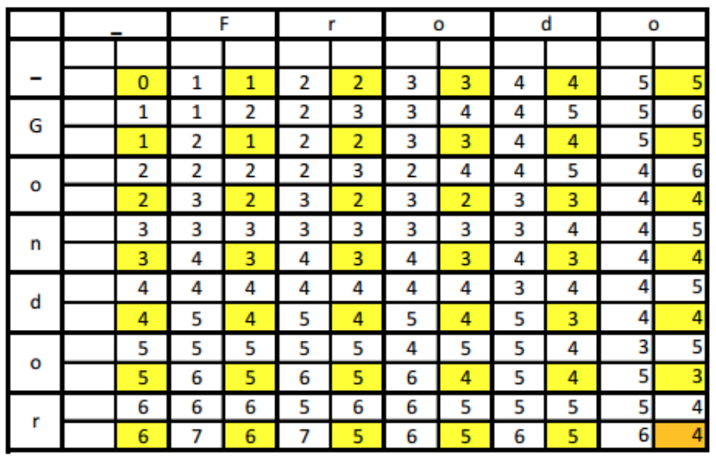
Task 5
Write down the full 6x5 array of distances between all prefixes as shown in the lecture 3. What is the minimum edit-distance between Frodo and Gondor.
Minimum edit-distance(Frodo, Gondor) = Lev(Frodo,Gondor) = 4

Slide 22
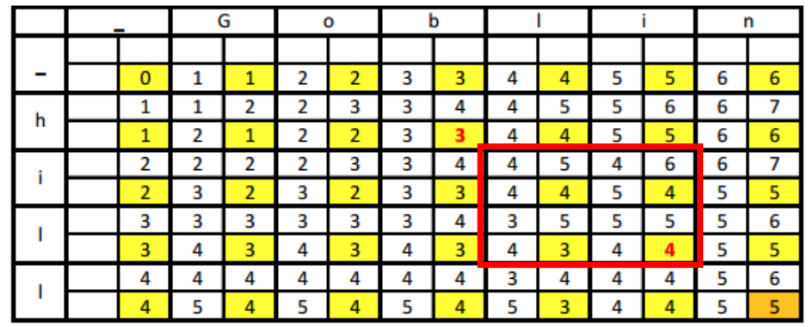

Task 6
What is the Levenshtein-Damerau distance between hill and goblin? Write down the solution in the same tabular format from the previous task.
Consider transposition only be-
cause the following condition is satisfied:
l i
Levenshtein-Damerau(Gobli,hil) = min(insertion=5, replacement=5, deletion=4, transposition=3+1)
Levenshtein-Damerau(Goblin,hill) = 5
practice with your own examples: http://www.let.rug.nl/kleiweg/lev/

Slide 23
Get the lengths of the two strings
Create a DP (Dynamic Programming) matrix of size (m+1) x (n+1)
Initialize the first row and column.
For i from 1 to m:
For j from 1 to n:
Calculate the cost of substitution
Calculate dp[i][j] based on deletion, insertion, substitution/match\
Check for Transposition
If transposition is possible compare the current dp[i][j] with the cost of transposition plus the cost of the subproblem before the transposed characters (dp[i-2][j-2]).
min(dp[i][j], dp[i-2][j-2] + 1)
Return dp[m][n]

Slide 24
Task 7
What is the Jaccard coefficient between the word bord and each of lord, morbid, and sordid when we treat them as bigrams?
Jaccard(bord, lord) = Jaccard({bo, or, rd,}, {lo, or, rd}) = 2 / 4
Jaccard(bord, morbid) = Jaccard({bo, or, rd}, {mo, or, rb, bi, id}) = 1 / 7
Jaccard(bord, sordid) = Jaccard({bo, or, rd}, {so, or, rd, di, id}) = 2 / 6
Notes:
What
- Measure of closesness that can be used to run spelling correction

