Slide 1
STORY MAP & MVP
Team 1:
Dang Quang Anh 20176632
Ngo Duc Anh 20176631
Nguyen Hoang Anh 20160132 (PM)
Tran Huy Anh 20176633
Phung Lam Ngoc Boi 20160382
Nguyen Thi Can 20176635

Slide 2
STORY MAP
Brainstorming:
Create backbone:
Security
Interior
Energy-saving
IoT
Flow
Door
lock
Fire
Alarm
Smoke
Alarm
Lights
Fans
Air
conditioner
Power System
App. control

Slide 3
STORY MAP
Security
Interior
Energy-saving
IoT
Flow
Door
lock
Fire
Alarm
Smoke
Alarm
Lights
Fans
Air
conditioner
Power System
App. control
Auto
lock
Alarm
Alarm
Auto.
Check status
Check status
Statistics
AI
Check status
Notify
Notify
Check
status
Change status
Change status
Analysis & advisory
Face ID
Change status
Voice comm.
Voice comm.
Solar panels
Necessity
Change status
Voice comm.

Slide 4
MVP
Security
Interior
Energy-saving
IoT
Flow
Door
lock
Fire
Alarm
Smoke
Alarm
Lights
Fans
Air
conditioner
Power System
App. control
Auto
lock
Alarm
Alarm
Auto.
Check status
Check status
Statistics
AI
Check status
Notify
Notify
Check
status
Change status
Change status
Analysis & advisory
MVP
Face ID
Change status
Voice comm.
Voice comm.
Solar panels
Necessity
Change status
Voice comm.

Slide 5
Group 2 Traffic Advisory Application
Members:
Le Manh duc (daily pm)
Tran duc cong
Do huu duc
Tran van duc
Le Nguyen dung
Nguyen tien dung

Slide 6
Input Information
Display Information
User Contribution
Flow
Enter User Location
Enter Destination
Display Warning
Display Traveling Route
Report
Rating
Text
Text
Overview of Traffic Flow
Shortest Route
Accident Location
GPS of Phones
Location Suggestion
Accident Location
Fastest Route
Traffic Jam Location
Location Suggestion
Voice
Traffic Jam Location
Recommend Traveling Time
Voice
Time Estimation
Max Speed
Necessity

Slide 7
STORY MAP
BY
Team #3
MEMBERS
Trần đức dũng - 20176638
Trương đức dũng - 20160713
Ngô hoàng Dương - 20176639 (pm)
Phan đại dương - 20160856
Vũ khắc dương - 20160878
Nguyễn trường giang - 20176641

Slide 8
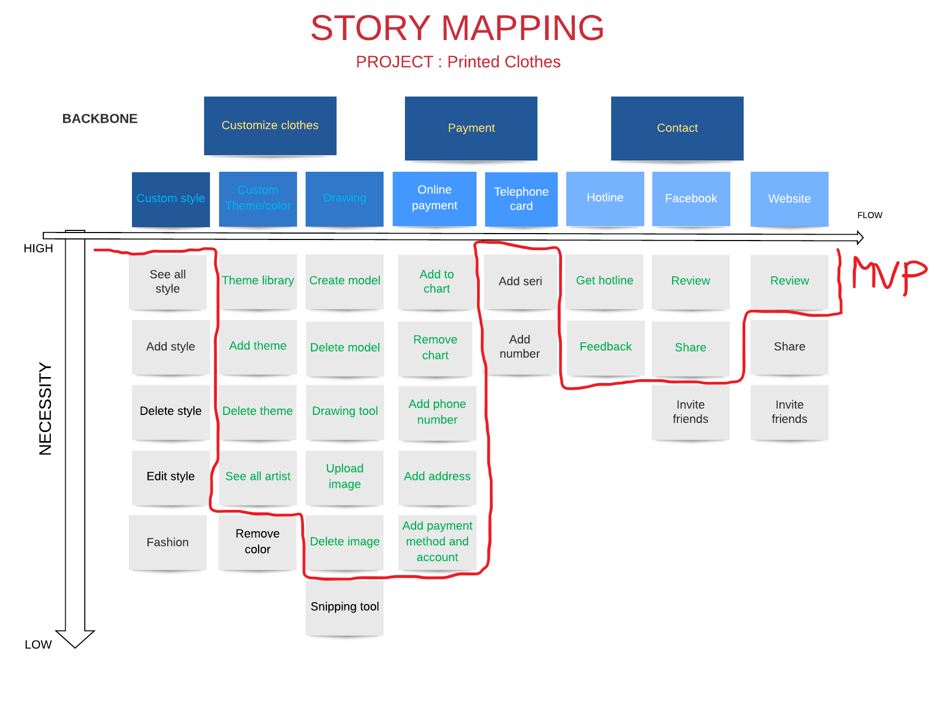

Slide 9
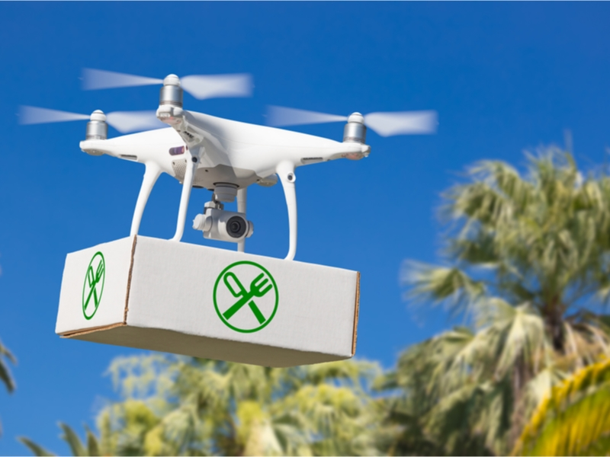
DRONE FOOD Delivery MVP
Hanoi, 11 March

Slide 10
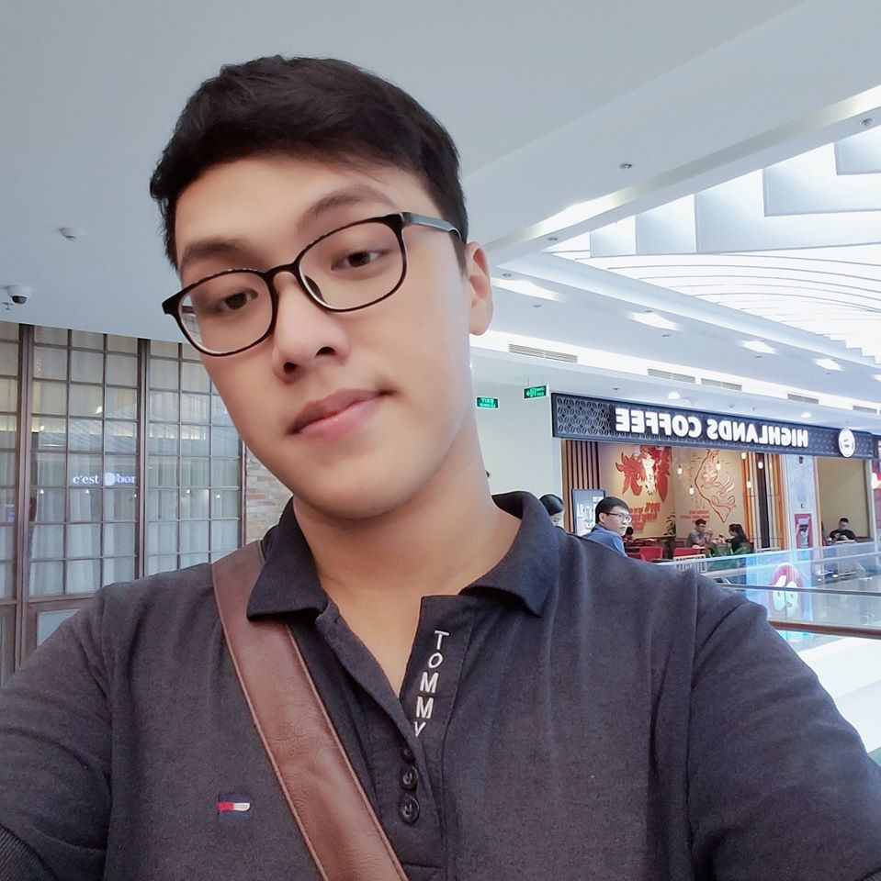
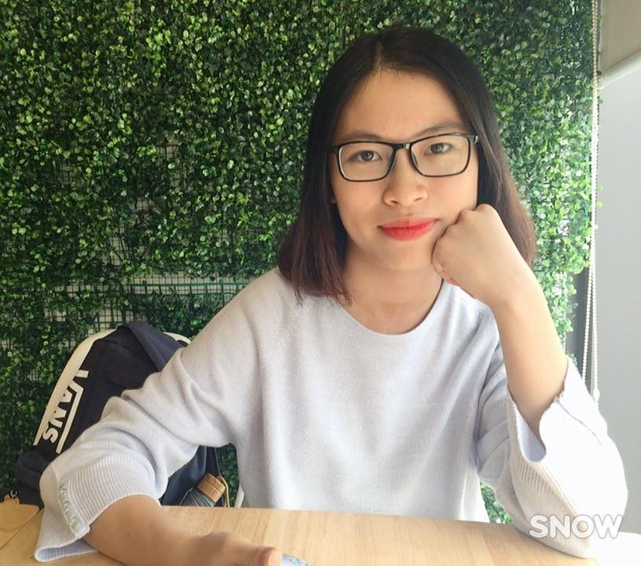
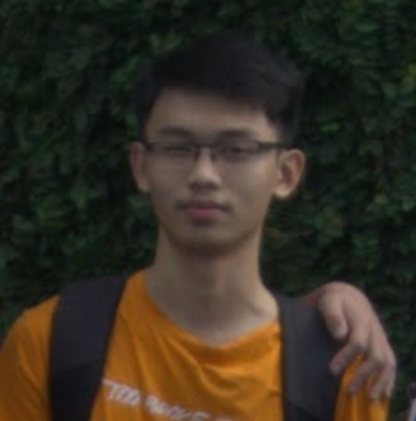
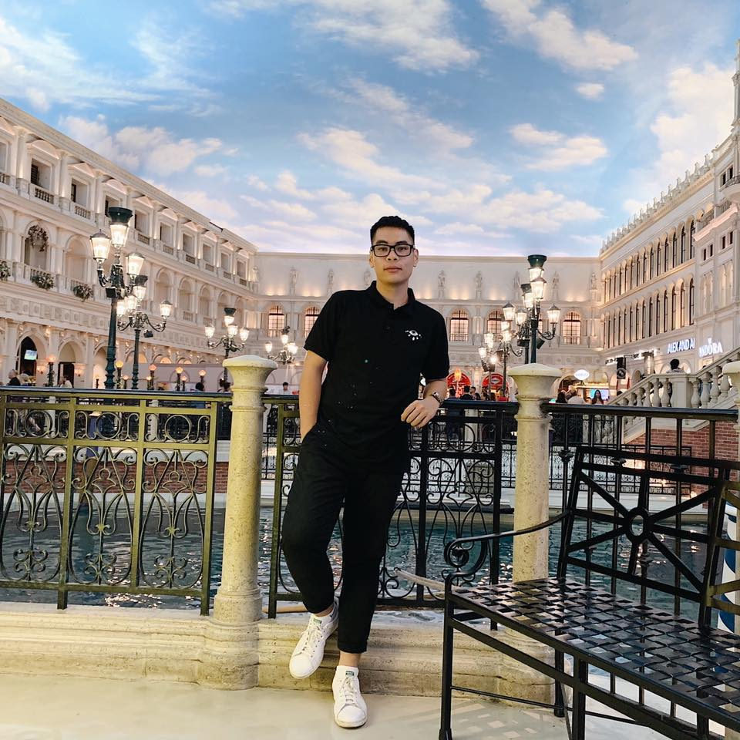
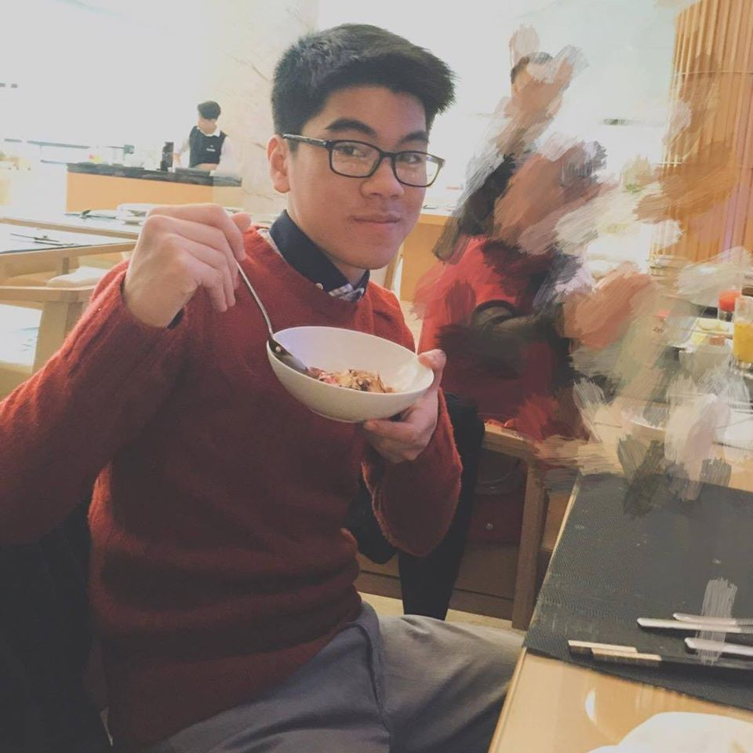
Group 4
THARIKA
HOÀNG HẢI (PM)
THU HÀ
TRUNG HIẾU
MINH HIẾU
MINH HIẾU A

Slide 11
USER FLOW ➔➔➔
Create account
On
boarding
Create new session
Ordering
Check Status
Payment & Confirm
Complete session
Get the order
Feedback
HIGH
Log in through FB + GG + Phone
Verify ID number, bday, phone, security question
Fill Name + location + phone number
Choose F&B
(Buy Now, Add to Cart)
Check available of drone
Confirm the order
Show location of Drone
Drone call + send message to phone number
Feedback food + Drone + waiting time
Fill the name + email + password
Verify email
Choose type of service + type of session
Check available of F & B
Send estimate price for customer
Sum all the money + apply promotion
Email confirm for payment + QR CODE
Drone check the QR CODE for type of payment + send the order
Give promotion to increase resale
If user not verify in 7 days, the account deleted
Credit card must be verified
Service: .Fast food, .Market, …
Choose time to get order
Choose the payment method
Link with bank account + E - wallet + COD
Take the photo upload your location
Payment: .Banking
.E wallet
.COD
(Cash on Delivery)
Find common of customer => increase target marketing
NECESSITY ➔➔➔
LOW
KEY: STEP FEATURE IDEA

Slide 12
THANK YOU!
Hardworking!!!
SAVE Your health ♥️ ♥️ ♥️

Slide 13
Group 5 PET CARING .MVP:Website shows the service of the local petstores when cusromers select the services online from a specific petstore. .Founders orders petstore serving the customers.

Slide 14
Necessity
Services
Pet store
Time
Contact
Flow
Select types
Select store
Set date
Confirm
Select quality pets
Select price level
Set time
Edit

Slide 15
Smart Farm
Group 6 : Nguyễn Mạnh Kiên
Nguyễn Trung Kiên
Tạ Thị Thanh Lâm (PM)
Vũ Tùng Lâm
Phạm Văn Lân
Chu Việt Long

Slide 16
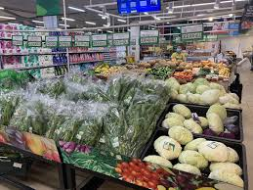
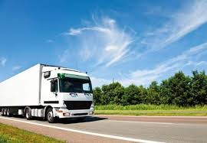
Smart farm
Product:
Fresh vegetables,
Delivery services
Customers:
Supermarkets, markets, shops
Local regions
Benefit:
Fresh and healthy vegetables
Conveniences

Slide 17
Smart farm
Infrastructure preparation
Starting
operation
Planting
Conditions controlling
Harvesting
Doing business
Prepare resources
Set up automatic machines
Seeds selection
Indicating watering, Cultivation schedule
Checking ripen fruits
Advertising
Construct farm
Technique inspection
Seeding
Collect temperature and humidity data
Harvesting
Sale
Soil planning
Watering
Modify to suitable temperature
Checking quality
Delivering
Necessity
Build arable land
Manuring
Send data to host computer, analysis
Storing and classify
Buy machines

Slide 18
Story map and MVP
Team - 7
Instructor :- Prof. Dr. Harald Wehnes
Group Members
Dao Duc Nguyen
Ha Thi Thanh Ngan
Pramod Manuja Wickramasinghe
Dang Tuan Long
Huynh Duc Minh ( Day 3 PM )
Nguyen Tien Nam

Slide 19
Team - 7

Slide 20
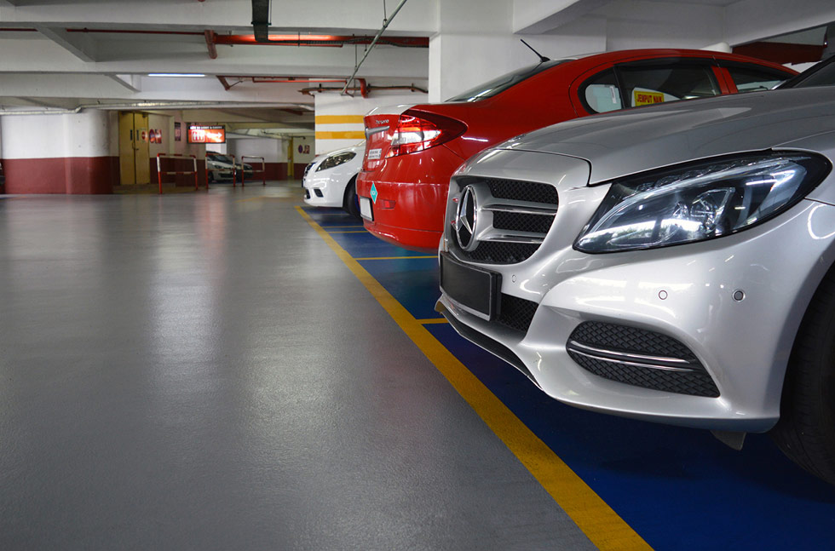
PROJECT:
MOBILE APP For Finding Parking Places
Team 8
Nguyen Minh Phuong ( Team manager )
Le Thuong Nguyen
Pham Hong Phuc
Hoang The Nguyen
Pham Van Quang
Nguyen Ba Quang

Slide 21
Story Map
MOBILE APP For Finding Parking Places

Slide 22
MVP
MOBILE APP For Finding Parking Places

Slide 23
Thanks for listening!

Slide 24
Team 9
FLOW
Work Operations |  |  |  | Account Settings | App Preferences
Search | Project Manage | Company Security | Data
Tasks | Staff | Database access | Organize | Login/out | Synchronization
Contracts/files | Workflow | Contracts access | Synchronization | Change account | Appearance
Contacts | Project Timeline | File access | Sharing | Permission
To-do list | Contracts | Workflow access |  | Authentication Method
 | To-do list
 | Social Networks
MVP
NECESSITY

Slide 25
Team 10: pdf

Slide 26
Team#11
Show the route
Analyse the traffic
Evaluate the traffic volume
Find the best route
Flow
Navigate user position
Notice the traffic data
Calculate the cars, motors,..
Optimize all
road
Show the predicted traffic jam
Warning the
user
Choose the best road for user
Navigate destination
Show the available route
Alert the traffic
jam
Necessity

Slide 27
Team 12
Story Map and MVP
Trịnh Lê Gia Tuyên-20164437(PM)
Phan Ngọc Tường-20164583
Nguyễn Quang Vinh-20164689
Nguyễn Thế Vinh-20167445
Nguyễn Hải Tùng -20176673
Trần Quang Vinh-20176674
Vũ Hải Yến -20176675

Slide 28
